Slide 1

Front end-Web-development - Bootcamp-Group-Project-1
Project Team –
Matt Dudman, Andrea Fontana, Ben Sadler

Slide 2
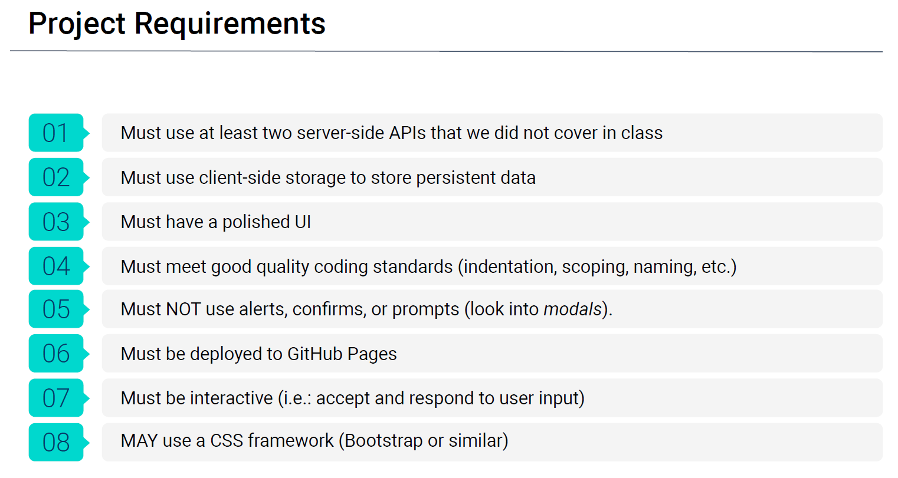

Build a web application from scratch which solves a real-world problem by integrating data received from multiple-server API requests. Meeting following project requirements:

Slide 3
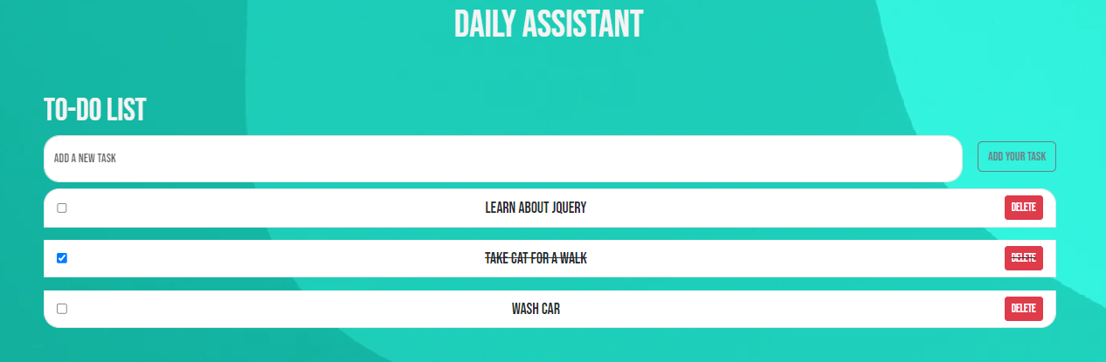
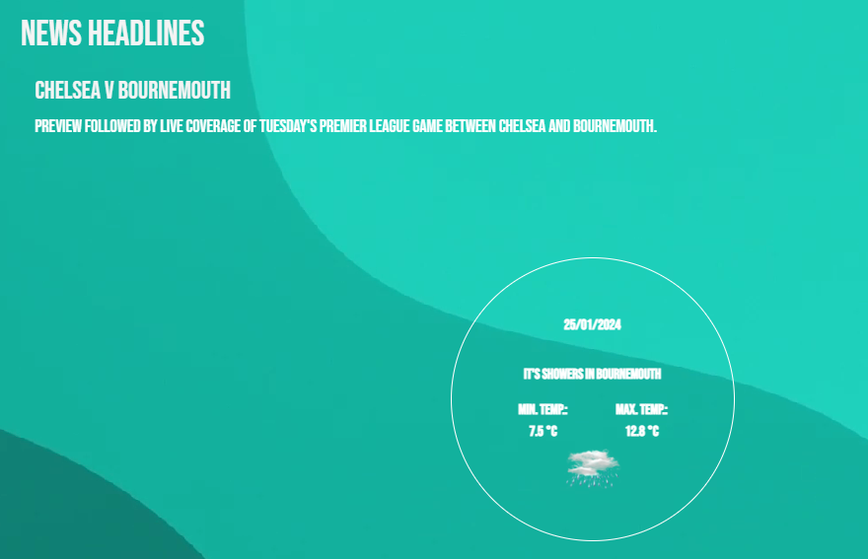
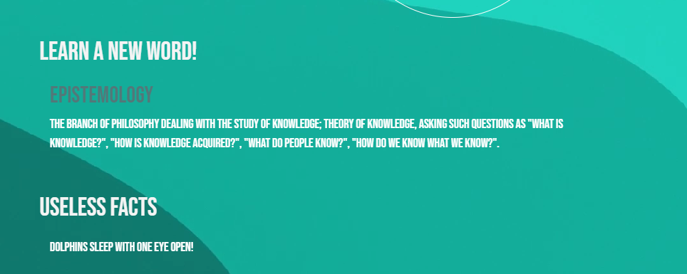
DAILY ASSISTANT APPLICATION
Project Team –
Matt Dudman, Andrea Fontana, Ben Sadler

Slide 4
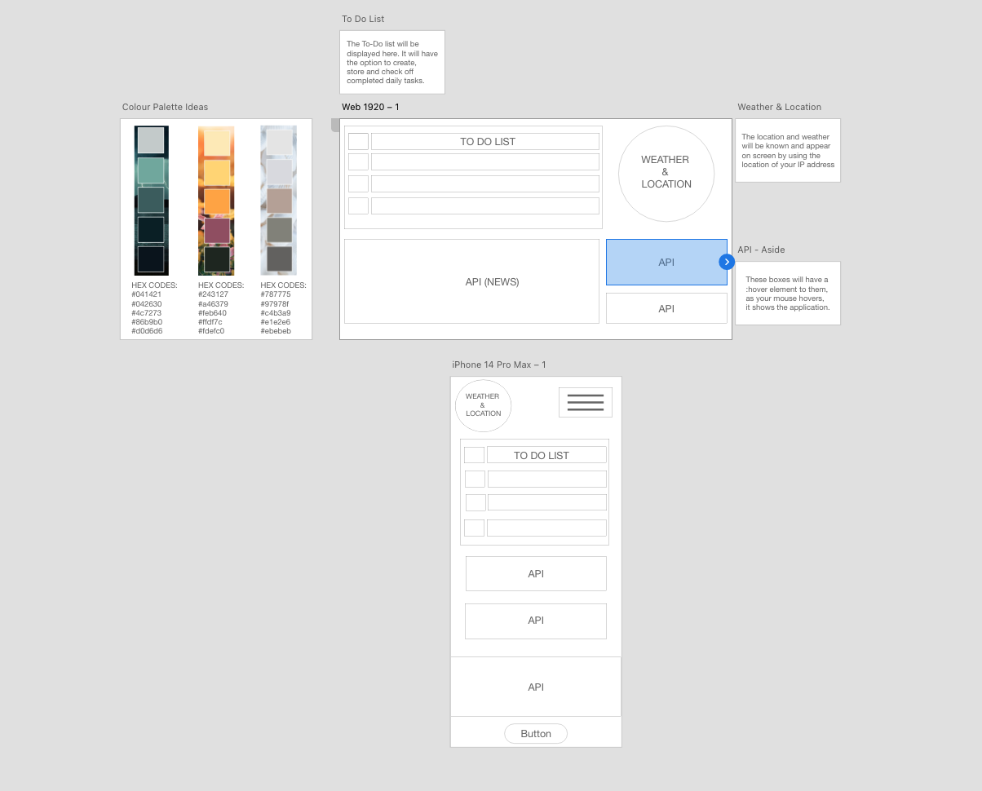
Concept
An interactive application which provides the user with tools and information to use daily.
Motivation for development?
To aid the user with planning their days and make them more productive.
User story
As a USER I want: A web based application which provides me with tools and information to use daily. The ability to add and remove items from a todo list and give me information that could be crucial to planning my day along with light hearted elements such as ‘Useless Fact’.
Why: To increase productivity and help me keep track of the tasks I need to do that is stored in one place.
Initial first design of wireframe

Slide 5

Process
Technologies used:
HTML, CSS, JavaScript, Bootstrap, GitHub, JQuery, Dayjs. Adobe XD, Google Fonts
APIs included:
Who did what?
Matt - Wireframe, To Do list, Styling, HTML, CSS, Javascript.
Ben - Weather Application inc. location specific, Random Word API, Dictionary API, Google Fonts, HTML, CSS, Javascript.
Andrea - News API, Useless Facts, HTML, CSS, Javascript.
Weather API: https://developer.accuweather.com/
Random Word API: https://api-ninjas.com/api/randomword
Dictionary API: https://dictionaryapi.dev/
Useless Fact API: https://uselessfacts.jsph.pl/
News API: https://www.thenewsapi.com/

Slide 6
Process
Challenges
Find APIs that would fit our needs without charging for it.
GitHub functionalities.
Mobile responsiveness. As we don’t have much time, we decided to change the main layout.
Successes
Working cohesively as a team for the first time in this environment.
Testing our knowledge of what we have learnt so far on the course and feeling pride within that.
Learning from each other.
Our ability to troubleshoot and problem solve issues with a positive attitude.
Our ability to be systematic, concise and work effectively to the deadline.

Slide 7
DEMONSTRATION

Slide 8
Directions for Future Development
Make the desktop layout with two columns to be able to add more features to the app.
Add a new section with water and exercises tracking with a few checkboxes for the user to track his activities.
Add buttons with links to the user’s email, LinkedIn, GitHub.
Create an area that the profile can be customised to the users preferences (eg colour, social media feed, gmail/outlook)

Slide 9
Links
Deployed application:
https://bena251.github.io/Bootcamp-Group-Project/
GitHub repository:
https://github.com/BenA251/Bootcamp-Group-Project/

